Slide 1
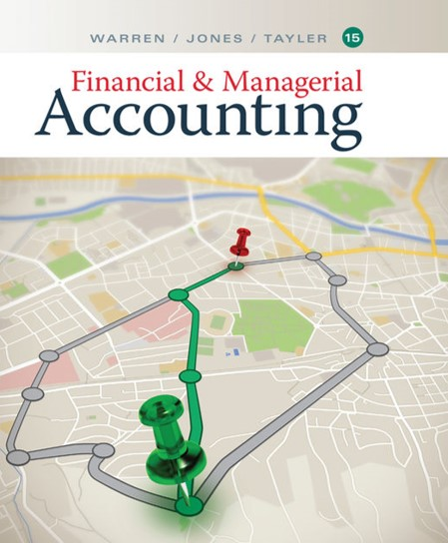

Financial & Managerial Accounting
Fifteenth Edition
Chapter 1
Introduction to Accounting and Business
Copyright © 2020 Cengage. All Rights Reserved.

Slide 2
Learning Objectives (1 of 2)
Obj. 1: Describe the nature of business and the role of accounting and ethics in business.
Obj. 2: Describe generally accepted accounting principles, including the underlying assumptions and principles.
Obj. 3: State the accounting equation and define each element of the equation.
Obj. 4: Describe and illustrate how business transactions can be recorded in terms of the resulting change in the elements of the accounting equation.

Slide 3
Learning Objectives (2 of 2)
Obj. 5: Describe the financial statements of a corporation and explain how they interrelate.
Obj. 6: Describe and illustrate the use of the ratio of liabilities to stockholders’ equity in evaluating a company’s financial condition.

Slide 4
Nature of Business and Accounting
A business is an organization in which basic resources (inputs), such as materials and labor, are assembled and processed to provide goods or services (outputs) to customers.
Profit is the difference between the amounts received from customers for goods or services and the amounts paid for the inputs used to provide the goods or services.

Slide 5
Types of Businesses
Service Businesses | Service
Delta Air Lines | Transportation services
The Walt Disney Company | Entertainment services
Merchandising Businesses | Product
Wal-Mart Stores, Inc. | General merchandise
Amazon.com | Internet books, music, videos, …
Manufacturing Businesses | Product
Ford Motor Company | Cars, trucks, vans
Merck & Co., Inc. | Pharmaceutical drugs

Slide 6
Role of Accounting in Business
Accounting can be defined as an information system that provides reports to users about the economic activities and condition of a business.
The process by which accounting provides information to users is as follows:
  Identify users.
  Assess users’ information needs.
  Design the accounting information system to meet users’ needs.
  Record economic data about business activities and events.
  Prepare accounting reports for users.

Slide 7
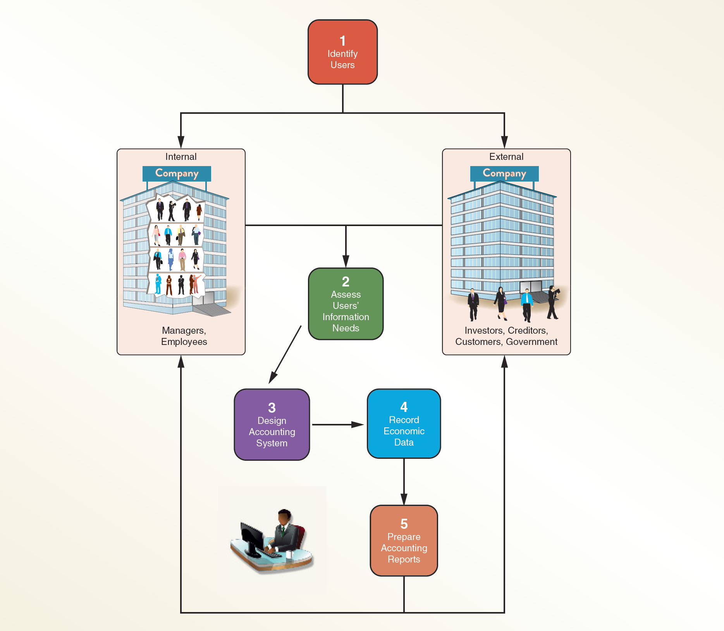
Accounting as an Information System

Slide 8
Managerial Accounting
Managerial accounting or management accounting provides timely information to internal users such as managers and employees to meet their decision-making needs.
Managerial accountants employed by a business are employed in private accounting.

Slide 9
Financial Accounting
Financial accounting provides relevant and timely information for the decision-making needs of users outside of the business, such as, investors, creditors, customers, and the government.
General-purpose financial statements are one type of financial accounting report that is distributed to external users.

Slide 10
Role of Ethics in Accounting and Business (1 of 4)
The objective of accounting is to provide relevant, timely information for user decision making.
Accountants must behave in an ethical manner so that the information they provide users will be trustworthy and, thus, useful for decision making.
Managers and employees must also behave in an ethical manner in managing and operating a business.
Ethics are moral principles that guide the conduct of individuals.

Slide 11
Accounting and Business Frauds
Company | Nature of Accounting or Business Fraud | Result
Computer Associates International, Inc. | Fraudulently inflated its financial results. | CEO and senior executives indicted. Five executives pled guilty, $225 million fine.
Enron | Fraudulently inflated its financial results. | Bankrupcty. Senior executives criminally convicted. More than $60 billion in stock market losses.
HealthSouth | Overstated performance by $4 billion in false entries. | Senior executives criminally convicted.
Qwest Communications International, Inc. | Improperly recognized $3 billion in false receipts. | CEO and six other executives criminally convicted of “massive financial fraud.” $250 million SEC fine.
Xerox Corporation | Recognized $3 billion in sales prior to when it should have been recorded. | $10 million fine to SEC. Six executives forced to pay $22 million.

Slide 12
Role of Ethics in Accounting and Business (2 of 4)
What went wrong for these managers and companies?
The answer normally involved one or both of the following two factors:
  Failure of individual character
  Culture of greed and ethical indifference

Slide 13
Role of Ethics in Accounting and Business (3 of 4)
As a result of the accounting and business frauds shown earlier, Congress passed laws to monitor the behavior of accounting and business, such as the Sarbanes-Oxley Act (SOX).
  SOX established a new oversight body for the accounting profession called the Public Company Accounting Oversight Board (PCAOB).
  SOX established standards for independence, corporate responsibility, and disclosure.

Slide 14
Role of Ethics in Accounting and Business (4 of 4)
Guidelines for behaving ethically:
  Identify an ethical decision by using your personal ethical standards of honesty and fairness.
  Identify the consequences of the decision and its effect on others.
  Consider your obligations and responsibilities to those who will be affected by your decision.
  Make a decision that is ethical and fair to those affected by it.

Slide 15
Opportunities for Accountants (1 of 2)
Numerous career opportunities are available for students majoring in accounting.
Currently, the demand for accountants exceeds the number of new graduates entering the job market.
  This is partly due to the increased regulation of business caused by accounting and business frauds.
  Also, more and more businesses have come to recognize the importance and value of accounting information.

Slide 16
Opportunities for Accountants (2 of 2)
Accountants employed by a business are employed in private accounting.
Accountants and their staff who provide services on a fee basis are said to be employed in public accounting.
  Public accountants who have met a state’s education, experience, and examination requirements may become Certified Public Accountants (CPAs).

Slide 17
Accounting Career Paths and Salaries (1 of 2)
Accounting Career Track | Description | Career Options | Annual Starting Salaries* | Certification
Private Accounting | Accountants employed by companies, government, and not-for –profit entities. | Bookkeeper | $40,000
 |  | Payroll clerk | $40,000 | Certified Payroll Professional (CPP)
 |  | General accountant | $51,000
 |  | Budget analyst | $53,000
 |  | Cost accountant | $55,000 | Certified Management Accountant (CMA)
 |  | Internal auditor | $62,000 | Certified Internal Auditor (CIA)
 |  | Information technology auditor | $71,000 | Certified Information Systems Auditor (CISA)

Slide 18
Accounting Career Paths and Salaries (2 of 2)
Accounting Career Track | Description | Career Options | Annual Starting Salaries* | Certification
Public Accounting | Accountants employed individually or within a public accounting firm in audit, tax, or management advisory services. | Large firms (over $250 million in revenue) | $68,000 | Certified Public Accountant (CPA)
 |  | Mid-size firms ($25–$250 million in revenue) | $61,000 | Certified Public Accountant (CPA)
 |  | Small firms (less than $25 million in revenue) | $56,000 | Certified Public Accountant (CPA)
*Average salaries rounded to the nearest thousand. Salaries may vary by size of company and region.
Source: Robert Half 2017 U.S. Salary Guide (Finance and Accounting), Robert Half International, Inc. (www.roberthalf.com/workplace-research/salary-guides).

Slide 19
Generally Accepted Accounting Principles (GAAP) (1 of 2)
Financial information in the United States is based on generally accepted accounting principles (GAAP).
GAAP is a collection of accounting standards, principles, and assumptions that define how financial information will be reported.
  Accounting standards are the rules that determine the accounting for individual business transactions.
  Accounting principles and assumptions provide the framework upon which accounting standards are constructed.

Slide 20
Generally Accepted Accounting Principles (GAAP) (2 of 2)
Within the United States, the Financial Accounting Standards Board (FASB) has the primary responsibility for developing accounting standards.
The Securities and Exchange Commission (SEC), an agency of the U.S. government, has authority over the accounting and financial disclosures for companies whose shares of ownership (stock) are traded and sold to the public.
Outside the United States, most countries use accounting standards and principles adopted by the International Accounting Standards Board (IASB).

Slide 21
Characteristics of Financial Information (1 of 2)
To be useful, financial reports must possess two important characteristics: relevance and faithful representation.
  Relevant information has the potential to impact decision making.
  Faithful representation means that the information accurately reflects an entity’s economic activity or condition.

Slide 22
Characteristics of Financial Information (2 of 2)
Characteristics of relevant and faithful representation are enhanced by the following:
  Comparability allows users to identify similarities and differences among reported items.
  Verifiability allows users to agree on the meaning of reported items.
  Timeliness requires distribution of the financial reports in time to influence a user’s decision.
  Understandability requires clear and concise financial reports that facilitate user interpretation and analysis.

Slide 23
Assumptions (1 of 5)
Financial accounting and generally accepted accounting principles are based upon the following assumptions:
  Monetary unit
  Time period
  Business entity
  Going concern

Slide 24
Assumptions (2 of 5)
The monetary unit assumption requires that financial reports be expressed in a single money unit, or currency.
  This provides a common measurement of the effects of economic events and transactions on an entity.
  The monetary unit used is normally determined by the country in which the company operates.

Slide 25
Assumptions (3 of 5)
The time period assumption allows a company to report its economic activities on a regular basis for a specific period of time.
  Financial condition and changes in financial condition are reported periodically on a consistent basis.
  Calendar year is the commonly used fiscal year, beginning on January 1, 20Y1, and ending on December 31, 20Y1.
  Natural business year is a 12-month period beginning on a date chosen by the company, usually the first of a month.

Slide 26
Assumptions (4 of 5)
The business entity assumption limits the economic data in financial reports to that directly related to the activities of the business.
  The business is viewed as an entity separate from its owners, creditors, or other businesses.

Slide 27
Forms of Business Entities (1 of 2)
Form of Business Entity | Characteristics and Advantages | Examples
Proprietorship is owned by one individual. | 70% of business entities in the United States. Easy and inexpensive to organize. Resources are limited to those of the owner. Used by small businesses. | A & B Painting
Partnership is owned by two or more individuals. | 10% of business organizations in the United States (combined with limited liability companies). Combines the skills and resources of more than one person. | Jones & Smith, Architects

Slide 28
Forms of Business Entities (2 of 2)
Form of Business Entity | Characteristics and Advantages | Examples
Corporation is organized under state or federal statutes as a separate legal taxable entity. | Generates 90% of business revenues. 20% of the business organizations in the United States. Ownership is divided into shares called stock. Can obtain large amounts of resources by issuing stock. Used by large businesses. | Alphabet Inc. (GOOG) Apple Inc. (AAPL) Ford Motor Company (F)
Limited liability Company (LLC) combines the attributes of a partnership and a corporation. | 10% of business organizations in the United States (combined with partnerships). Often used as an alternative to a partnership. Has tax and legal liability advantages for owners. | Boston Basketball Partners, LLC

Slide 29
Assumptions (5 of 5)
The going concern assumption requires that financial reports be prepared assuming that the entity will continue operating into the future.

Slide 30
Principles (1 of 5)
The following four principles are an integral part of financial accounting:
  Measurement
  Historical cost
  Revenue recognition
  Expense recognition

Slide 31
Principles (2 of 5)
The measurement principle determines the amount that will be recorded and reported.
  The measurement principle requires that amounts be objective and verifiable.
    An amount is objective if it is based upon independent, unbiased evidence.
    An amount is verifiable if it can be confirmed by a third party.
  Transactions between two independent parties, called arm’s-length transactions, provide amounts that are objective and verifiable.

Slide 32
Principles (3 of 5)
Recording an item at its initial transaction price is called the historical cost principle or cost principle.
  Under the historical cost principle, amounts do not normally change until another transaction occurs.

Slide 33
Principles (4 of 5)
Revenue is the amount earned (received) from providing services or selling goods to customers.
The revenue recognition principle determines when revenue is recorded in the accounting records.
  Normally, revenue is recorded when the services have been performed or goods are delivered to the customer.

Slide 34
Principles (5 of 5)
Expenses are amounts used to generate revenue.
The expense recognition principle, sometimes called the matching principle, requires expenses to be recorded in the same period as the related revenue.
  Doing so allows the reporting of a profit or loss for the period.

Slide 35
The Accounting Equation (1 of 2)
The resources owned by a business are called assets.
The rights of creditors are the debts of the business and are called liabilities.
The rights of owners are called equity.
  Since stockholders own a corporation, equity is called stockholders’ equity.
  For a proprietorship, partnership, or limited liability company, equity is called owner’s equity.

Slide 36
The Accounting Equation (2 of 2)
The following equation is called the accounting equation:
Assets = Liabilities + Stockholders’ Equity
Liabilities usually are shown before equity in the accounting equation because creditors have first rights to the assets.

Slide 37
Business Transactions and the Accounting Equation
An economic event or condition that directly changes an entity’s financial condition or its results of operations is a business transaction.
All business transactions can be stated in terms of changes in the elements of the accounting equation.
  For example, a company purchasing land for $50,000 is a business transaction.

Slide 38
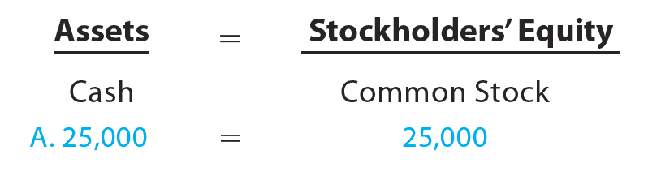
Transaction A
On November 1, 20Y3, Chris Clark deposited $25,000 in a bank account in the name of NetSolutions in exchange for shares of common stock in the corporation.
A corporation issues common stock to investors as proof of their ownership rights.

Slide 39
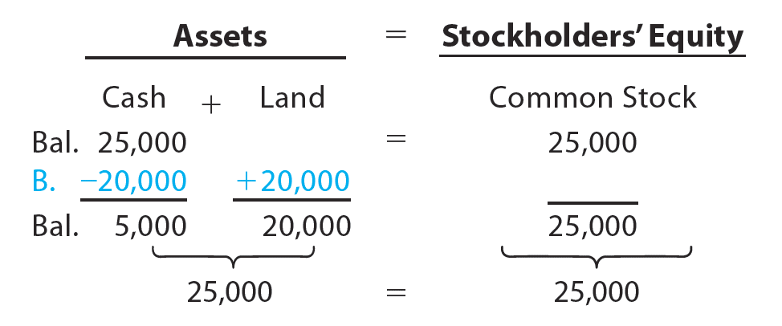
Transaction B
On November 5, 20Y3, NetSolutions paid $20,000 for the purchase of land as a future building site.

Slide 40
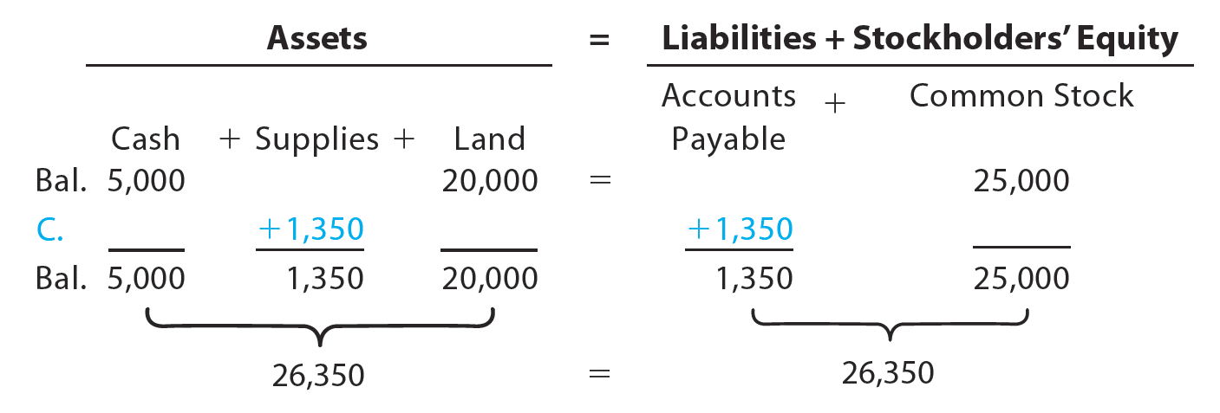
Transaction C
On November 10, 20Y3, NetSolutions purchased supplies for $1,350 and agreed to pay the supplier in the near future.
The liability created by a purchase on account is called an account payable.
Items such as supplies that will be used in the business in the future are called prepaid expenses, which are assets.

Slide 41
Transaction D (1 of 4)
A business earns money by selling goods or services to its customers. This amount is called revenue.

Slide 42
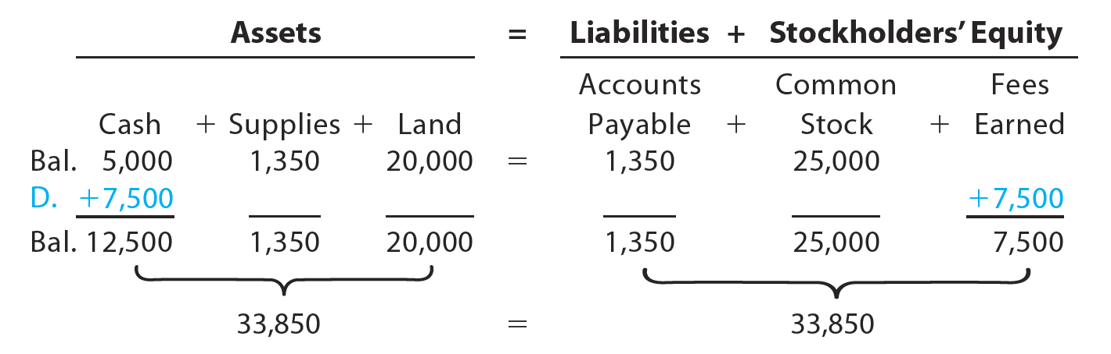
Transaction D (2 of 4)
On November 18, 20Y3, NetSolutions received cash of $7,500 for providing services to customers.

Slide 43
Transaction D (3 of 4)
Revenue from providing services is recorded as fees earned.
Revenue from the sale of merchandise is recorded as sales.
Other examples of revenue include rent revenue, and interest revenue.
An account receivable is a claim against the customer, which is an asset.

Slide 44
Transaction D (4 of 4)
Instead of receiving cash at the time services are provided or goods are sold, a business may accept payment at a later date.
  Such revenues are described as fees earned on account or sales on account.
    In such cases, the firm has an asset, called an account receivable, which is a claim against the customer.

Slide 45
Transaction E (1 of 2)
During the month, NetSolutions spent cash or used up other assets in earning revenue. Assets used in this process of earning revenue are called expenses.

Slide 46
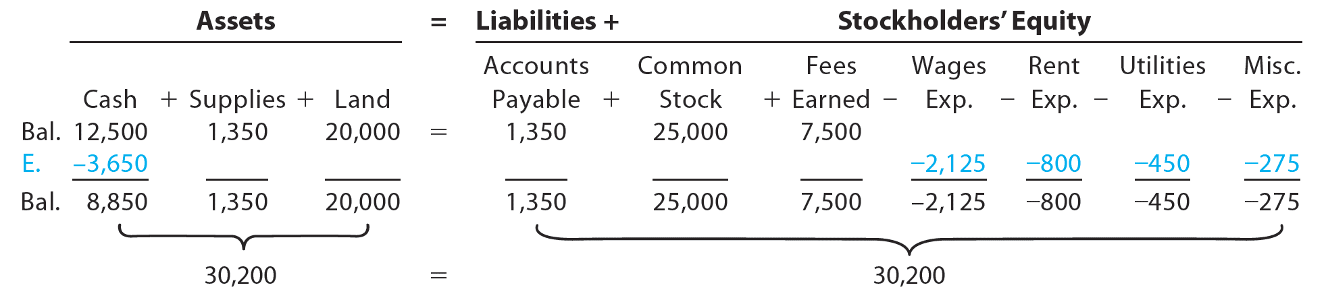
Transaction E (2 of 2)
On November 30, 20Y3, NetSolutions paid the following expenses: wages, $2,125; rent, $800; utilities, $450; and miscellaneous, $275.

Slide 47
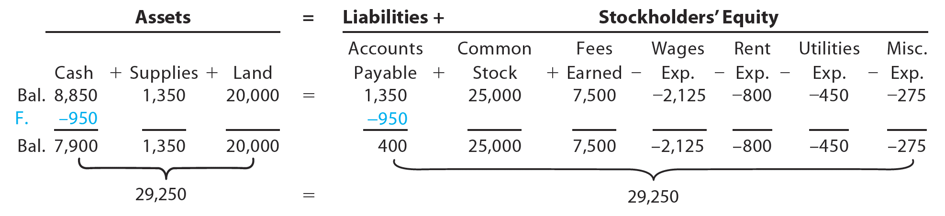
Transaction F
On November 30, 20Y3, NetSolutions paid creditors on account, $950.

Slide 48
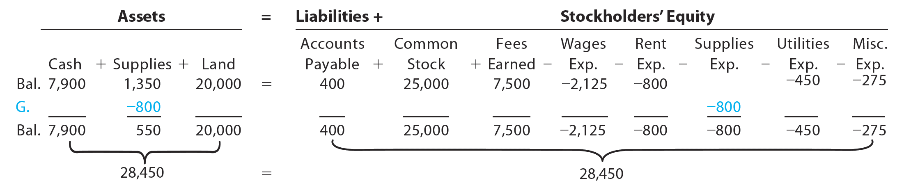
Transaction G
On November 30, 20Y3, Chris Clark determined that the cost of supplies on hand at the end of the month was $550.
  $800 ($1,350 – $550) of supplies must have been used during the month.

Slide 49
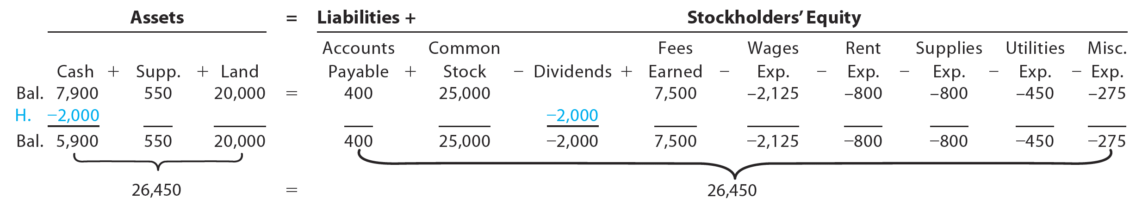
Transaction H
On November 30, 20Y3, NetSolutions paid dividends of $2,000.
  Dividends are distributions of earnings to stockholders.

Slide 50
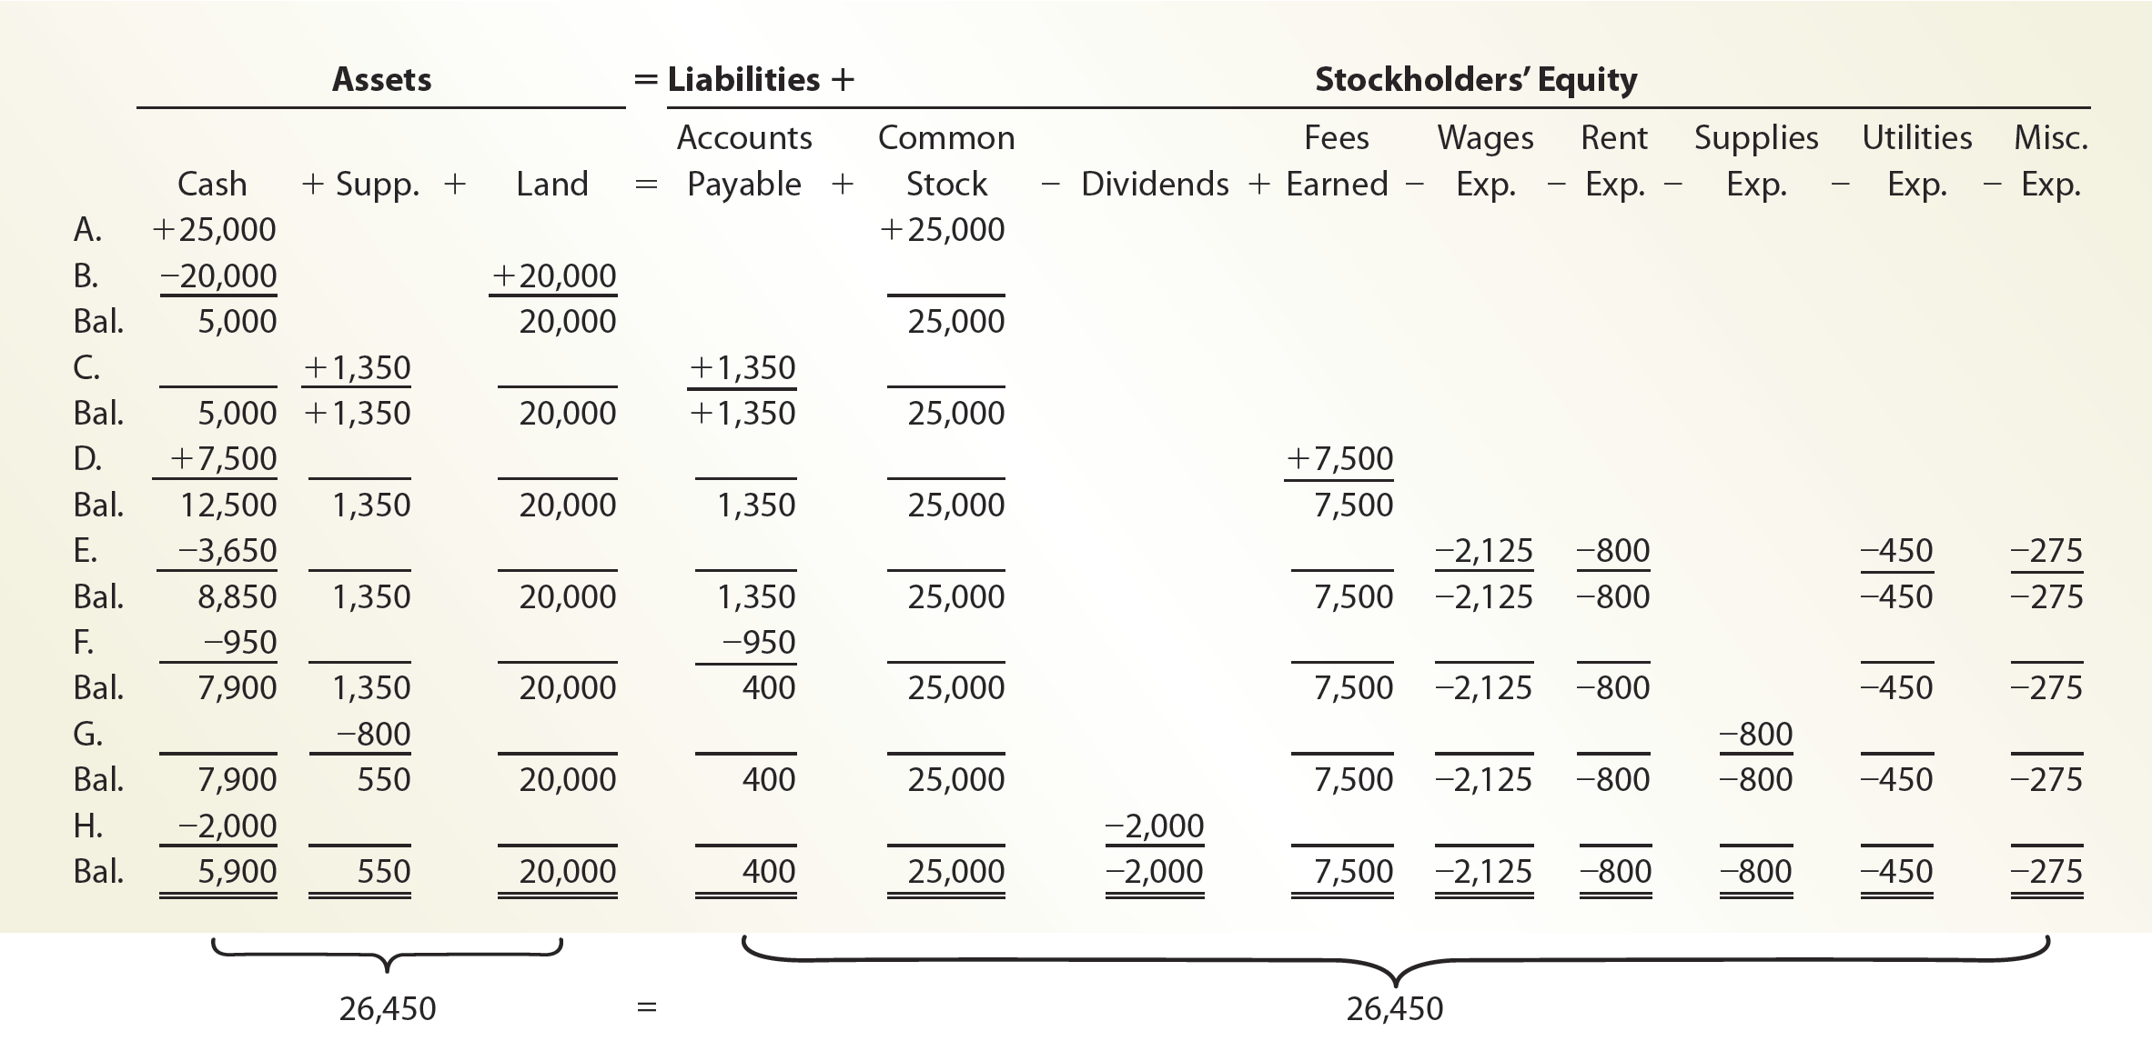
Summary of Transactions for NetSolutions (1 of 2)

Slide 51
Summary of Transactions for NetSolutions (2 of 2)
The effect of every transaction is an increase or a decrease in one or more of the accounting equation elements.
The two sides of the accounting equation are always equal.
The stockholders’ equity is increased by amounts invested by stockholders (common stock).
The stockholders’ equity is increased by revenues and decreased by expenses.
The stockholders’ equity is decreased by dividends paid to stockholders.

Slide 52
Classifications of Stockholders’ Equity (1 of 3)
Stockholders’ equity is classified as:
  Common Stock
  Retained Earnings

Slide 53
Classifications of Stockholders’ Equity (2 of 3)
Common stock is shares of ownership distributed to investors of a corporation.
  It represents the portion of stockholders’ equity contributed by investors.
Retained earnings is the stockholders’ equity created from business operations through revenue and expense transactions.

Slide 54
Classifications of Stockholders’ Equity (3 of 3)
Stockholders’ equity created by investments by stockholders (common stock) and by business operations (retained earnings) are reported separately.

Slide 55
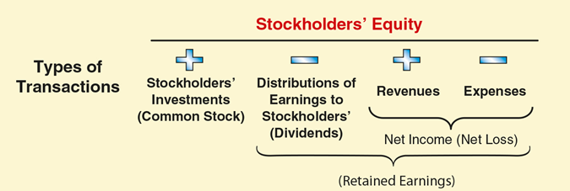
Effects of Transactions on Stockholders’ Equity

Slide 56
Check Up Corner: Business Transactions and the Accounting Equation (1 of 3)
Drive Time Delivery is a local delivery service operating in Cleveland, Ohio. At the beginning of the month, February 1, Drive Time has the following account balances: Cash, $32,500; Accounts Receivable, $5,000; Accounts Payable, $2,500; Common Stock, $32,500; Fees Earned, $5,000; Wages Expense, $2,500.
The following selected transactions were completed by the company during the month of February:
    Received cash from owner as an additional investment in common stock, $20,000.
    Paid creditors on account, $2,000.
    Received cash from customers on account, $5,000.

Slide 57
Check Up Corner: Business Transactions and the Accounting Equation (2 of 3)
    Billed customers for delivery services on account, $18,000.
    Paid wages expense, $10,000.
    Paid utilities expense, $3,000.
    Paid dividends, $4,500.
Prepare a table to indicate the effect that each of these transactions has on the following asset, liability, and stockholders’ equity accounts: Cash, Accounts Receivable, Accounts Payable, Common Stock, Dividends, Fees Earned, Wages Earned, Utilities Expense.

Slide 58
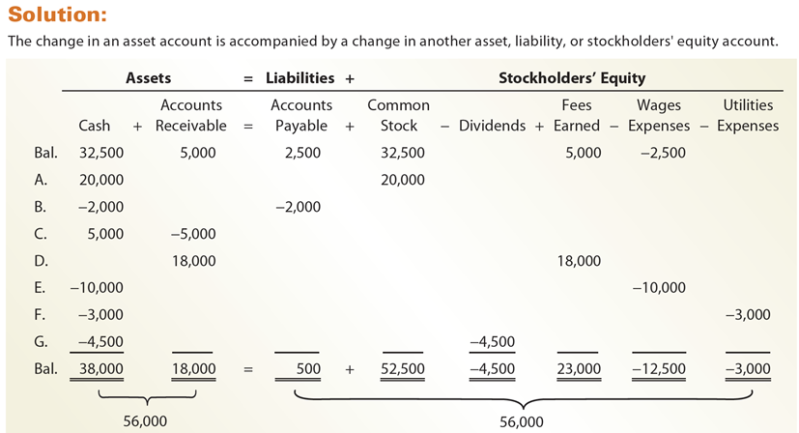
Check Up Corner: Business Transactions and the Accounting Equation (3 of 3)

Slide 59
Financial Statements
After transactions have been recorded and summarized, reports are prepared for users. The accounting reports providing this information are called financial statements.
The primary financial statements of a corporation are the:
  Income statement and stmt of comprehensive income
  Statement of stockholders’ equity
  Balance sheet
  Statement of cash flows

Slide 60
Financial Statements Order and Nature
Order Prepared | Financial Statement | Description of Statement
1. | Income statement | A summary of the revenue and expenses for a specific period of time, such as a month or a year.
2. | Statement of stockholders’ equity | A summary of the changes in stockholders’ equity that have occurred during a specific period of time, such as a month or a year.
3. | Balance sheet | A list of the assets, liabilities, and stockholders’ equity as of a specific date, usually at the close of the last day of a month or a year.
4. | Statement of cash flows | A summary of the cash receipts and cash payments for a specific period of time, such as a month or a year.

Slide 61
Income Statement
The income statement reports the revenues and expenses for a period of time, based on the revenue and expense recognition principles.
  These principles match revenues and their related expenses so that they are reported in the same period.
The excess of the revenue over the expenses is called net income, net profit, or earnings.
If expenses exceed revenue, the excess is a net loss.

Slide 62
Statement of Stockholders’ Equity
The statement of stockholders’ equity reports the changes in the retained earnings and common stock for a period of time.
It is prepared after the income statement because the net income or net loss for the period must be reported in this statement.
Similarly, it is prepared before the balance sheet, since the amounts of common stock and retained earnings at the end of the period must be reported on the balance sheet.

Slide 63
Balance Sheet
A balance sheet reports the amounts of assets, liabilities, and stockholders’ equity as of a specific date.
The report form presents a balance sheet in a vertical format.

Slide 64
Statement of Cash Flows (1 of 4)
A statement of cash flows consists of the following three sections:
  operating activities
  investing activities
  financing activities

Slide 65
Statement of Cash Flows (2 of 4)
The cash flows from operating activities section reports a summary of cash receipts and cash payments from operations.
The net cash flow from operating activities normally differs from the amount of net income for the period.
This difference occurs because revenues and expenses may not be recorded at the same time that cash is received from customers or paid to creditors.

Slide 66
Statement of Cash Flows (3 of 4)
The cash flows from investing activities section reports the cash transactions for the acquisition and sale of relatively permanent assets.

Slide 67
Statement of Cash Flows (4 of 4)
The cash flows from financing activities section reports the cash transactions related to cash investments by stockholders, borrowings, and dividends.

Slide 68
Financial Statement Interrelationships
Financial Statements | Interrelationship | NetSolutions Example
Income Statement and Statement of Stockholders’ Equity | Net income or net loss reported on the income statement is also reported on the statement of stockholders’ equity as either an addition (net income) to or deduction (net loss) from the beginning retained earnings. | NetSolutions’ net income of $3,050 for November is added to the Beginning retained earnings on November 1, 20Y3, of $0 on the statement of stockholders’ equity.
Statement of Stockholders’ Equity and Balance Sheet | Common stock, retained earnings, and total stockholders’ equity at the end of the period are reported on the statement of stockholders’ equity and balance sheet. | NetSolutions’ common stock of $25,000, retained earnings of $1,050, and total stockholders’ equity of $26,050 as of November 30, 20Y3, are also reported on the balance sheet.
Balance Sheet and Statement of Cash Flows | The cash reported on the balance sheet is also reported as the end-of-period cash on the statement of cash flows. | Cash of $5,900 reported on the balance sheet as of November 30, 20Y3, is also reported on the November statement of cash flows as the end-of-period cash.

Slide 69
Check Up Corner: Financial Statements (1 of 3)
Levart Travel Service’s assets and liabilities at December 31, 20Y6, the end of the year, and its revenue and expenses for the year follow:
Accounts payable | $ 12, 200 | Land | $ 90,000
Accounts receivable | 31,350 | Miscellaneous expense | 12,950
Cash | 53,050 | Office expense | 63,000
Common stock | 100,000 | Supplies | 3,350
Fees earned | 263,200 | Wages expense | 131,700

Slide 70
Check Up Corner: Financial Statements (2 of 3)
The retained earnings were $30,000 on January 1, 20Y6, the beginning of the year. During the year, no common stock was issued and dividends of $20,000 were paid.
    Prepare an income statement for the year ended December 31, 20Y6.
    Prepare a statement of stockholders’ equity for the year ended December 31, 20Y6.
    Prepare a balance sheet as of December 31, 20Y6.
    Show the interrelationships of these three financial statements.

Slide 71
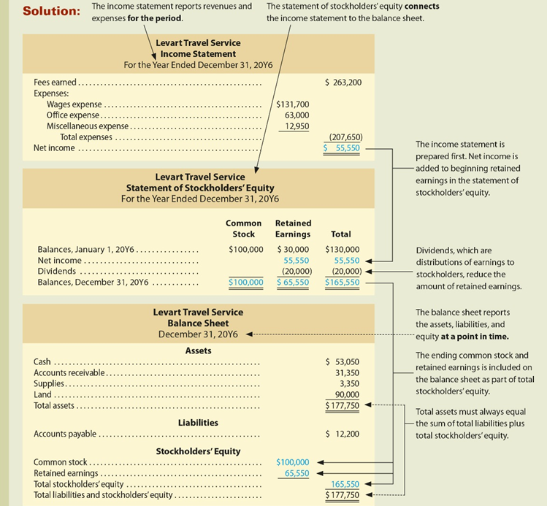
Check Up Corner: Financial Statements (3 of 3)

Slide 72
Analysis for Decision Making: Ratio of Liabilities to Stockholders’ Equity (1 of 4)
The ratio of liabilities to stockholders’ equity is useful in analyzing the ability of a company to pay its creditors.
The ratio of liabilities to stockholders’ equity is computed as follows:

Slide 73
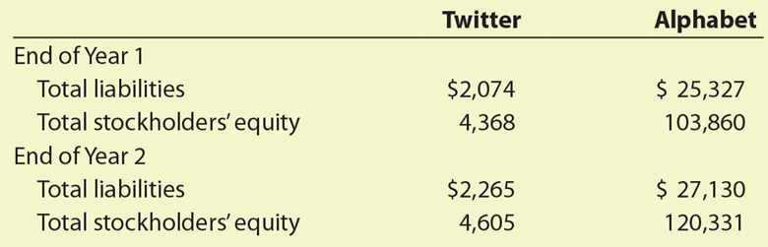
Analysis for Decision Making: Ratio of Liabilities to Stockholders’ Equity (2 of 4)
To illustrate, the following data (in millions) from recent balance sheets of Twitter (TWTR) and Alphabet (GOOG) are used.

Slide 74
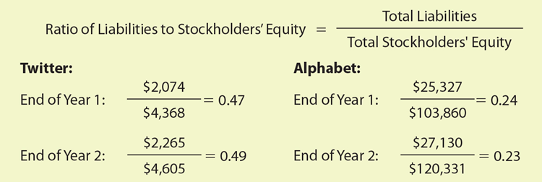
Analysis for Decision Making: Ratio of Liabilities to Stockholders’ Equity (3 of 4)
The ratios of liabilities to stockholders’ equity for Twitter and Alphabet are computed as follows:

Slide 75
Analysis for Decision Making: Ratio of Liabilities to Stockholders’ Equity (4 of 4)
The lower the ratio of liabilities to stockholders’ equity, the better able the company is to withstand poor business conditions and to pay its obligations to creditors.
Ratios less than 1.0 are protective to creditors.

